Slide 1
ECEG-5193: Algorithm Analysis and Design
Analysis of Sorting and Searching algorithms
Analysis of Simple Algorithms

Slide 2
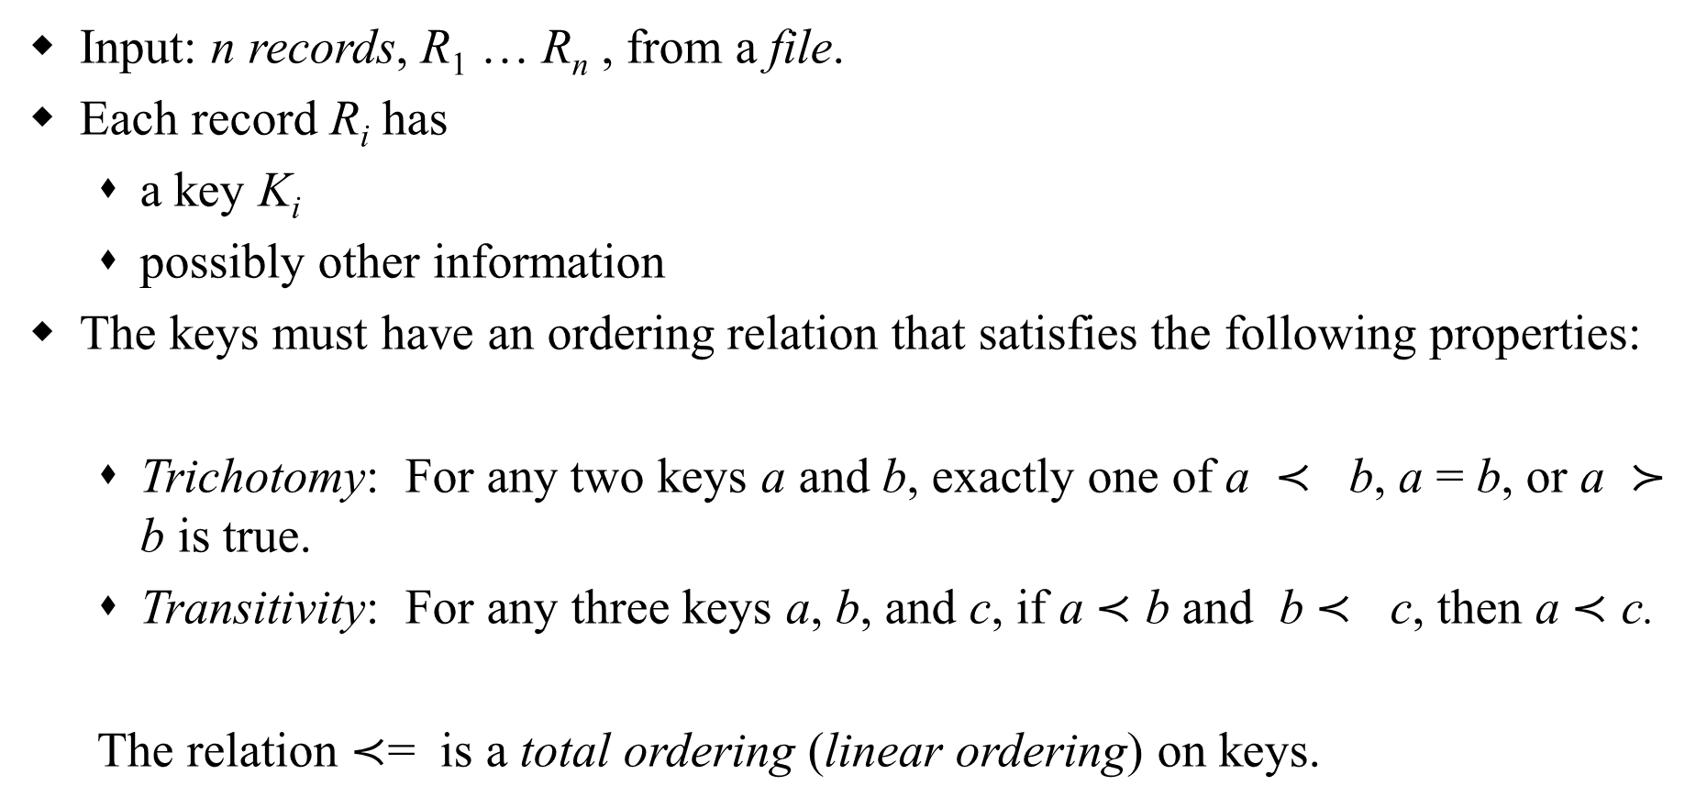
Sorting – Definitions
Input: n records, R₁ … R_{n} , from a file.
Each record R_{i} has
a key K_{i}
possibly other information
The keys must have an ordering relation that satisfies the following properties:
Trichotomy: For any two keys a and b, exactly one of a $≺$ b, a = b, or a $≻$ b is true.
Transitivity: For any three keys a, b, and c, if a $≺$ b and b $≺$ c, then a $≺$ c.
The relation $≺$= is a total ordering (linear ordering) on keys.
Notes:
Precedes succeeds

Slide 3
Sorting – Definitions
Sorting: determine a permutation Π = (p₁, … , p_{n}) of n records that puts the keys in non-decreasing order Kp₁ < … < Kp_{n}.
Permutation: a one-to-one function from
{1, …, n} onto itself. There are n! distinct permutations of n items.
Rank: Given a collection of n keys, the rank of a key is the number of keys that precede it. That is, rank(K_{j}) = |{K_{i}| K_{i} < K_{j}}|. If the keys are distinct, then the rank of a key gives its position in the output file.

Slide 4
Sorting Terminology
Internal (the file is stored in main memory and can be randomly accessed) vs. External (the file is stored in secondary memory & can be accessed sequentially only)
Comparison-based sort: uses only the relation among keys, not any special property of the representation of the keys themselves.
Stable sort: records with equal keys retain their original relative order; i.e., i < j & Kp_{i} = Kp_{j} ⇒ p_{i} < p_{j}
Array-based (consecutive keys are stored in consecutive memory locations) vs. List-based sort (may be stored in nonconsecutive locations in a linked manner)
In-place sort: needs only a constant amount of extra space in addition to that needed to store keys.

Slide 5
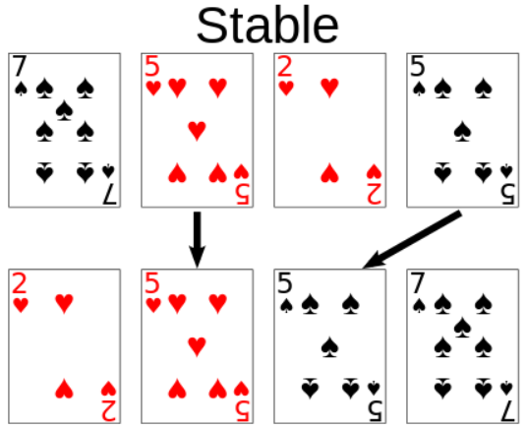
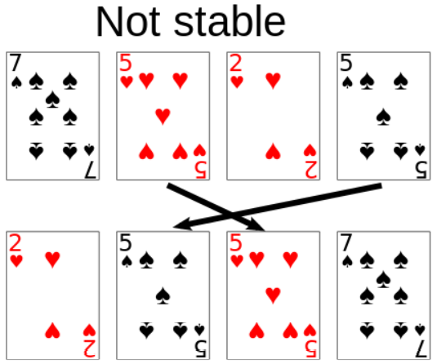
Stable Sort

Slide 6
Sorting Categories
Sorting by Insertion insertion sort, shellsort
Sorting by Exchange bubble sort, quicksort
Sorting by Selection selection sort, heapsort
Sorting by Merging merge sort
Sorting by Distribution radix sort

Slide 7
Sorting Algorithms
Internal sort
Collection of data fits in memory
External sort
Collection of data does not all fit in memory
Must reside on secondary storage

Slide 8
Elementary Sorting Methods
Easier to understand the basic mechanisms of sorting.
Good for small files.
Good for well-structured files that are relatively easy to sort, such as those almost sorted.
Can be used to improve efficiency of more powerful methods.

Slide 9
Elementary Sorting Algorithms
The Selection Sort
The Bubble Sort
The Insertion Sort

Slide 10
Selection Sort
Selection-Sort(A, n)
1. for i = n downto 2 do
2. max ← i
3. for j = i – 1 downto 1 do
4. if A[max] < A[j] then
5. max ← j
6. t ← A[max]
7. A[max] ← A[i]
8. A[i] ← t

Slide 11
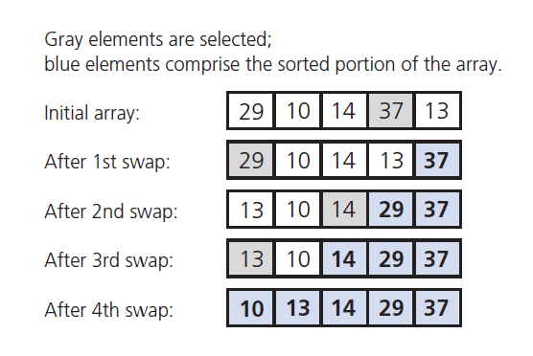
The Selection Sort

Slide 12
Selection Sort
i
63 | 25 | 12 | 22 | 11
void selectionSort(int[] a)
{ for (int i = 0; i < a.length - 1; i++)
{ int min = i; for (int j = i + 1; j < a.length; j++)
{ if (a[j] < a[min])
{ min = j; } } if (i != min)
{ int swap = a[i]; a[i] = a[min]; a[min] = swap; } } }
i
min
63 | 25 | 12 | 22 | 11
i
min
11 | 25 | 12 | 22 | 63
i
min
11 | 12 | 25 | 22 | 63
i, min
11 | 12 | 22 | 25 | 63
i, min
11 | 12 | 22 | 25 | 63

Slide 13
Selection Sort: Algorithm Analysis
The number of comparisons is Θ(n²) in all cases.
Can be improved by a some modifications, which leads to heapsort.

Slide 14
The Selection Sort
Analysis
Selection sort is O(n²)
Appropriate only for small n,
O(n²) grows rapidly
Could be a good choice when
Data moves are costly,
But comparisons are not

Slide 15
The Bubble Sort
Compares adjacent items
Exchanges them if out of order
Requires several passes over the data
When ordering successive pairs
Largest item bubbles to end of the array

Slide 16
Bubble Sort: Example
5 | 1 | 4 | 2 | 8
5 | 1 | 4 | 2 | 8
1 | 5 | 4 | 2 | 8
for (i = n-1 ; i > 0 ; i--)
for (j = 0; j < i ; j++)
if (a[j] < a[j+1])
swap a[j] and a[j+1]
1 | 5 | 4 | 2 | 8
1 | 4 | 5 | 2 | 8
1 | 4 | 5 | 2 | 8
1 | 4 | 2 | 5 | 8
1 | 4 | 2 | 5 | 8
1 | 4 | 2 | 5 | 8
1 | 4 | 2 | 5 | 8
1 | 4 | 2 | 5 | 8
1 | 4 | 2 | 5 | 8
1 | 2 | 4 | 5 | 8
1 | 2 | 4 | 5 | 8
1 | 2 | 4 | 5 | 8
1 | 2 | 4 | 5 | 8
1 | 2 | 4 | 5 | 8
1 | 2 | 4 | 5 | 8
1 | 2 | 4 | 5 | 8
1 | 2 | 4 | 5 | 8
1 | 2 | 4 | 5 | 8

Slide 17
The Bubble Sort
Analysis
Worst case O(n²)
Best case (array already in order) is O(n)

Slide 18
Insertion Sort
InsertionSort(A, n)
1. for j = 2 to n do
2. key ← A[j]
3. i ← j – 1
4. while i > 0 and key < A[i]
5. A[i+1] ← A[i]
6. i ← i – 1
7. A[i+1] ← key

Slide 19
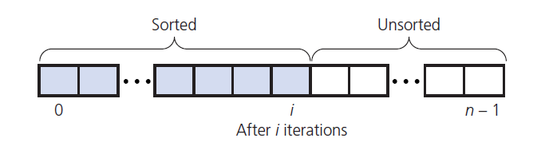
The Insertion Sort
Take each item from unsorted region
Insert it into correct order in sorted region

Slide 20
Insertion Sort
InsertionSort(array A) begin for i := 1 to length[A] - 1 do begin value := A[ i ]; j := i - 1; while j >= 0 and A[ j ] > value do begin A[ j + 1] := A[ j ]; j := j - 1; end; A[ j + 1] := value; end; end;
63 | 25 | 12 | 22 | 11
63 | 25 | 12 | 22 | 11
25 | 63 | 12 | 22 | 11
25 | 63 | 12 | 22 | 11
12 | 25 | 63 | 22 | 11
12 | 25 | 63 | 22 | 11
12 | 22 | 25 | 63 | 11
12 | 22 | 25 | 63 | 11
11 | 12 | 22 | 25 | 63

Slide 21
The Insertion Sort
Analysis
Worst case O(n²)
Best case (array already in order) is O(n)
Appropriate for small (n < 25) arrays
Unsuitable for large arrays
Unless already sorted

Slide 22
The Insertion Sort: Algorithm Analysis
No. of Comparisons:
If A is sorted: Θ(n) comparisons
If A is reverse sorted: Θ(n²) comparisons
If A is randomly permuted: Θ(n²) comparisons

Slide 23
The Insertion Sort: Worst-case Analysis
The maximum number of comparisons while inserting A[i] is (i-1). So, the number of comparisons is
C_{wc}(n) ≤ ∑_{i = 2 to n} (i -1)
= ∑_{j = 1 to n-1} j
= n(n-1)/2
= Θ(n²)
For which input does insertion sort perform n(n-1)/2 comparisons?

Slide 24
The Insertion Sort: Average-case Analysis
Want to determine the average number of comparisons taken over all possible inputs.
Determine the average no. of comparisons for a key A[j].
A[j] can belong to any of the j locations, 1..j, with equal probability.
The number of key comparisons for A[j] is j–k+1, if A[j] belongs to location k, 1 < k ≤ j and is j–1 if it belongs to location 1.
Average no. of comparisons for inserting key A[j] is:
Notes:
If it’s in slot 1 or slot 2, it still has to do i-1 comparisons.

Slide 25
The Insertion Sort: Average-case Analysis
Summing over the no. of comparisons for all keys,
Therefore, T_{avg}(n) = Θ(n²)

Slide 26
Analysis of Inversions in Permutations
Inversion: A pair (i, j) is called an inversion of a permutation Π if i < j and Π(i) > Π(j).
Worst Case: n(n-1)/2 inversions. For what permutation?
Average Case:
Let Π^{T} = {Π₁, Π₂, …, Π_{n} } be the transpose of Π.
Consider the pair (i, j) with i < j, there are n(n-1)/2 pairs.
(i, j) is an inversion of Π if and only if (n-j+1, n-i+1) is not an inversion of Π^{T}.
This implies that the pair (Π, Π^{T}) together have n(n-1)/2 inversions.
⇒ The average number of inversions is n(n-1)/4.

Slide 27
Theorem
Theorem: Any algorithm that sorts by comparison of keys and removes at most one inversion after each comparison must do at least n(n-1)/2 comparisons in the worst case and at least n(n-1)/4 comparisons on the average.
So, if we want to do better than Θ(n²) , we have to remove more than a constant number of inversions with each comparison.

Slide 28
Shellsort
Simple extension of insertion sort.
Gains speed by allowing exchanges with elements that are far apart (thereby fixing multiple inversions).
h-sort the file
Divide the file into h subsequences.
Each subsequence consists of keys that are h locations apart in the input file.
Sort each h-sequence using insertion sort.
Will result in h h-sorted files. Taking every hth key from anywhere results in a sorted sequence.
h-sort the file for decreasing values of increment h, with h=1 in the last iteration.
h-sorting for large values of h in earlier iterations, reduces the number of comparisons for smaller values of h in later iterations.
Correctness follows from the fact that the last step is plain insertion sort.

Slide 29
Shellsort
A family of algorithms, characterized by the sequence {h_{k}} of increments that are used in sorting.
By interleaving, we can fix multiple inversions with each comparison, so that later passes see files that are “nearly sorted.” This implies that either there are many keys not too far from their final position, or only a small number of keys are far off.

Slide 30
Shellsort
ShellSort(A, n)
1. h ← 1
2. while h ≤ n {
3. h ← 3h + 1
4. }
5. repeat
6. h ← h/3
7. for i = h to n do {
8. key ← A[i]
9. j ← i
10. while key < A[j - h] {
11. A[j] ← A[j - h]
12. j ← j - h
13. if j < h then break
14. }
15. A[j] ← key
16. }
17. until h ≤ 1
When h=1, this is insertion sort.
Otherwise, performs insertion sort on keys h locations apart.
h values are set in the outermost repeat loop. Note that they are decreasing and the final value is 1.

Slide 31
Algorithm Analysis
In-place sort
Not stable
The exact behavior of the algorithm depends on the sequence of increments -- difficult & complex to analyze the algorithm.
For h_{k} = 2^{k} - 1, T(n) = Θ(n^{3/2} )

Slide 32
Summary
Name | Best | Average | Worst | Stable
Insertion Sort | n | n² | n² | Yes
Selection Sort | n² | n² | n² | No
Bubble Sort | n | n² | n² | Yes
Shell Sort | n log n | n^{4/3} | n^{3/2} | No

Slide 33
Animations
Basic Sorting Algorithms
Shell-Sort

